Slide 1
Introduction

Slide 2
General Instruction
We will follow B.SC.CSIT 4th Semester Database Management System Syllabus designed by Tribhuvan University (TU).
Internal Evaluation will be done on the basis of task performed on Teams.
To perform practical, Student should have Laptop where VMware workstation should be installed.

Slide 3
Why DBMS Knowledge is important? (Discussion)
Notes:
Banking Sector
Mobile Sector
Web Application
Accounting Sector

Slide 4
Top Job related to Database
Data Analyst
Data modeler
Database Developer
Database Administrator
Data Scientist

Slide 5
Course Objectives
The general objective of this subject are to provide the basic concept, theory and practices in design and implementation of DBMS.
Students will also be good for handling different type of data transaction by using SQL commands.

Slide 6
Syllabus

Slide 7
Laboratory Works
According to Syllabus, Lab works should be done covering all the topics listed above using Oracle and a small project work should be carried out using the concept learnt in this course. Project should be assigned on Individual Basis.
Deployment of Linux machine
Installation of MariaDB or MySQL on Linux.
Installation of Oracle on Linux.
Creating DB, Creating Table, Inserting value in Table and other SQL Operations.
Projects: School/Collage Management System; Office Management System; Hospital Management System; Hotel Management System; Product Management System.

Slide 8
General IQ

Slide 9
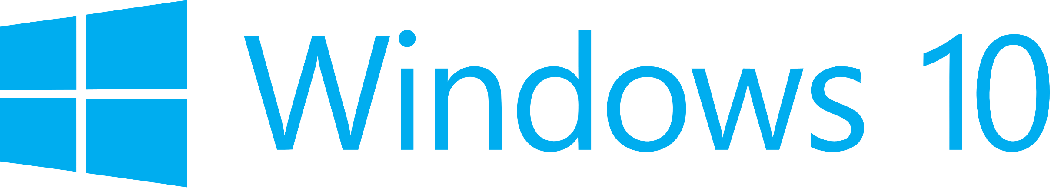
Notes:
Windows 10 is a series of operating systems developed by Microsoft and released as part of its Windows NT family of operating systems. It is the successor to Windows 8.1, released nearly two years earlier, and was released to manufacturing on July 15, 2015, and broadly released for the general public on July 29, 2015.

Slide 10
Windows 10
Windows 10 is a series of operating systems developed by Microsoft and released as part of its Windows NT family of operating systems. It is the successor to Windows 8.1, released nearly two years earlier, and was released to manufacturing on July 15, 2015, and broadly released for the general public on July 29, 2015.
It works as a client Operation System or personal computing.
Latest update version of windows 10 is 2004 (OS build 19041.388)

Slide 11
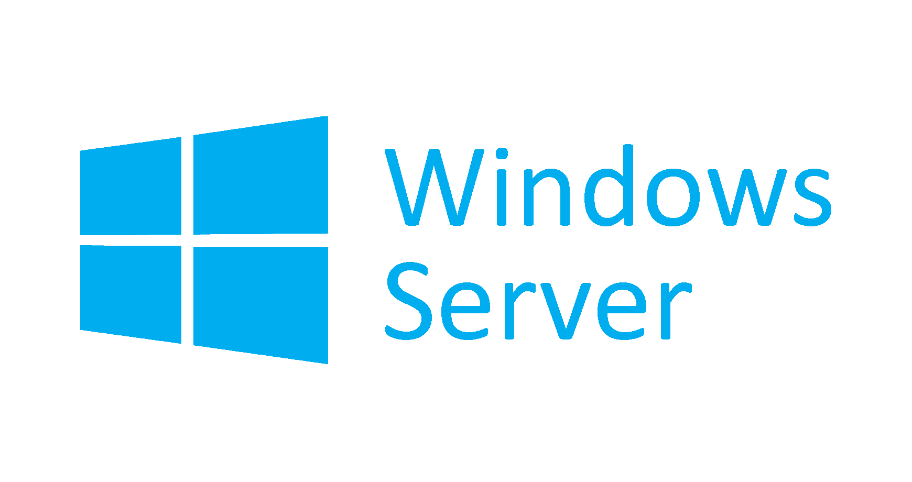
Notes:
Windows Server 2019 is the latest version of the Windows Server server operating system by Microsoft, as part of the Windows NT family of operating systems, developed concurrently with Windows 10. It succeeded Windows Server 2016, announced on March 20, 2018 and being officially released to the public on October 2, 2018.

Slide 12
Windows Server 2019
Windows Server 2019 is the latest version of the Windows Server which is server operating system by Microsoft, as part of the Windows NT family of operating systems, developed concurrently with Windows 10. It succeeded Windows Server 2016, announced on March 20, 2018 and being officially released to the public on October 2, 2018.
Support Status: Mainstream Support – Until 9 January 2024; Extended Support – Until 9 January 2029.
Windows Server 2016 Support Status: Mainstream Support – Until 12 October 2021; Extended Support – Until 12 October 2026.

Slide 13
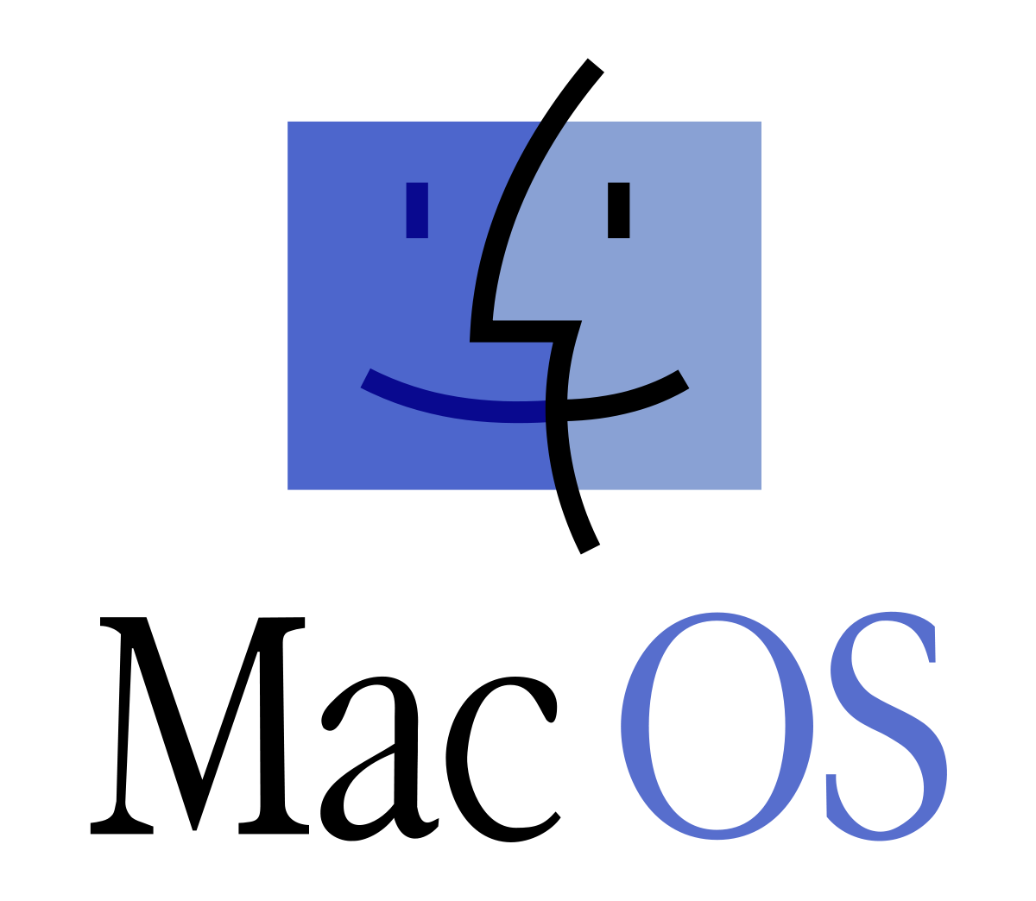
Notes:
macOS previously Mac OS X and later OS X) is a series of proprietary graphical operating systems developed and marketed by Apple Inc. since 2001. It is the primary operating system for Apple's Mac computers. Within the market of desktop, laptop and home computers, and by web usage, it is the second most widely used desktop OS, after Microsoft Windows.

Slide 14
macOS
macOS (previously Mac OS X and later OS X) is a series of proprietary graphical operating systems developed and marketed by Apple Inc. since 2001. It is the primary operating system for Apple's Mac computers. Within the market of desktop, laptop and home computers, and by web usage, it is the second most widely used desktop OS, after Microsoft Windows.
Latest version is known as macOS 10.15 Catalina.
Latest Release version is 10.15.6 released on 15 July 2020.
Upcomming version is macOS 11.0 Big Sur.

Slide 15
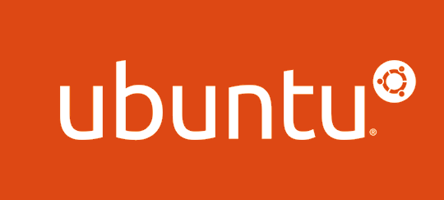
Notes:
Ubuntu is a Linux distribution based on Debian mostly composed of free and open-source software.[8][9][10] Ubuntu is officially released in three editions: Desktop,[11] Server,[12] and Core[13] for Internet of things devices[14] and robots.[15][16] All the editions can run on the computer alone, or in a virtual machine.[17] Ubuntu is a popular operating system for cloud computing, with support for OpenStack.[18]

Slide 16
Ubuntu
Ubuntu is a Linux distribution based on Debian mostly composed of free and open-source software.
Ubuntu is officially released in three editions: Desktop, Server, and Core for Internet of things devices and robots.
All the editions can run on the computer alone, or in a virtual machine.
Ubuntu is a popular operating system for cloud computing, with support for OpenStack.
Latest Release version is Ubuntu 20.04 “Focal Fossa” released on 23 April 2020.
Supported Until 2025 Under public support and until 2030 as a paid option.

Slide 17


Notes:
1 May 2019 logo changed.
Red Hat, Inc. is an American multinational software company that provides open source software products to enterprises. Founded in 1993, Red Hat has its corporate headquarters in Raleigh, North Carolina, with other offices worldwide. It became a subsidiary of IBM on July 9, 2019.
Linux Torvalds

Slide 18
Red Hat Enterprise Linux
Red Hat Enterprise Linux (often abbreviated to RHEL) is a Linux distribution developed by Red Hat for the commercial market.
It became a subsidiary of IBM on July 9, 2019.
Red Hat Enterprise Linux is released in server versions for x86-64, Power ISA, ARM64, and IBM Z and a desktop version for x86-64.
All of Red Hat's official support and training, together with the Red Hat Certification Program, focuses on the Red Hat Enterprise Linux platform.
Latest Release RHEL 8.2 on 28 April, 2020 and provide support upto 28 April 2030.

Slide 19

Notes:
CentOS (/ˈsɛntɒs/, from Community Enterprise Operating System^{[6][7]}) is a Linux distribution that provides a free, community-supported computing platform functionally compatible with its upstream source, Red Hat Enterprise Linux (RHEL).^{[8][9]} In January 2014, CentOS announced the official joining with Red Hat while staying independent from RHEL,^{[10]} under a new CentOS governing board.^{[11][12]}

Slide 20
CentOS
CentOS, from Community Enterprise Operating System is a Linux distribution that provides a free, community-supported computing platform functionally compatible with its upstream source, Red Hat Enterprise Linux (RHEL).
In January 2014, CentOS announced the official joining with Red Hat while staying independent from RHEL under a new CentOS governing board.
Latest Release CentOS 8.2.2004 on 15 June 2020 and support till 15 June 2030.

Slide 21

Notes:
Oracle Linux (abbreviated OL, formerly known as Oracle Enterprise Linux or OEL) is a Linux distribution packaged and freely distributed by Oracle, available partially under the GNU General Public License since late 2006.^{[4]} It is compiled from Red Hat Enterprise Linux (RHEL) source code, replacing Red Hat branding with Oracle's. It is also used by Oracle Cloud and Oracle Engineered Systems such as Oracle Exadata and others.

Slide 22
Oracle Linux
Oracle Linux (formerly known as Oracle Enterprise Linux or OEL) is a Linux distribution packaged and freely distributed by Oracle, available partially under the GNU General Public License since late 2006.
It is compiled from Red Hat Enterprise Linux (RHEL) source code, replacing Red Hat branding with Oracle's. It is also used by Oracle Cloud and Oracle Engineered Systems such as Oracle Exadata and others.
Latest release Oracle Linux 8.2 on 6 May 2020 and support upto 6 May 2030.

Slide 23

Notes:
Kali Linux is a Debian-derived Linux distribution designed for digital forensics and penetration testing.^{[4]} It is maintained and funded by Offensive Security.
Used for Vulnerablility Assesment & Penetration testing (VAPT).

Slide 24
Kali Linux
Kali Linux is a Debian-derived Linux distribution designed for digital forensics and penetration testing.
It is maintained and funded by Offensive Security.
Kali Linux has over 600[6] preinstalled penetration-testing programs.
Latest release Kali Linux 2020.2 on 12 May 2020.

Slide 25
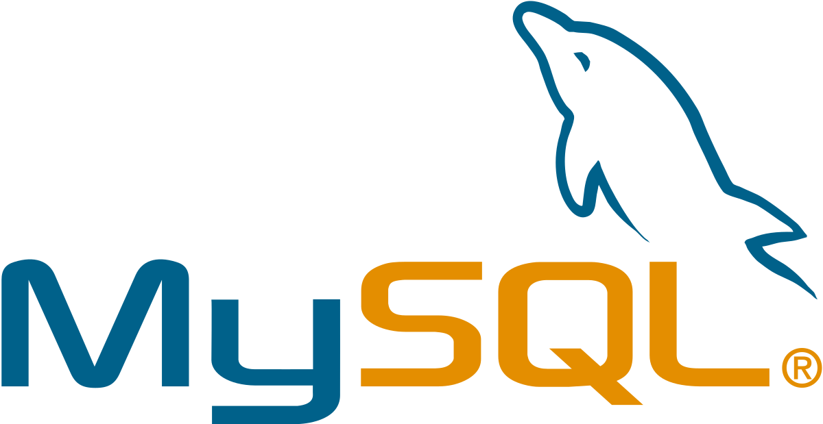

Slide 26
MySQL
MySQL is an open-source relational database management system (RDBMS).
Its name is a combination of "My", the name of co-founder Michael Widenius's daughter,[7] and "SQL", the abbreviation for Structured Query Language.
MySQL is free and open-source software under the terms of the GNU General Public License, and is also available under a variety of proprietary licenses.
MySQL was owned and sponsored by the Swedish company MySQL AB, which was bought by Sun Microsystems (now Oracle Corporation). In 2010, when Oracle acquired Sun, Widenius forked the open-source MySQL project to create MariaDB.

Slide 27
Platform: Linux, Windows, and Mac. Languages: C, Java, SQL, C++, Perl, Python, Tcl, and PHP. Cloud Version: Yes
Features:
The tool provides Scalability and Flexibility
The tool has web and data warehouse strengths
It provides high Performance
It has Robust Transactional Support
Mysql Community server 8.0.21 is the latest version.
Verdict: MySQL can be used for packaged software, and business-critical systems and high-volume websites.

Slide 28
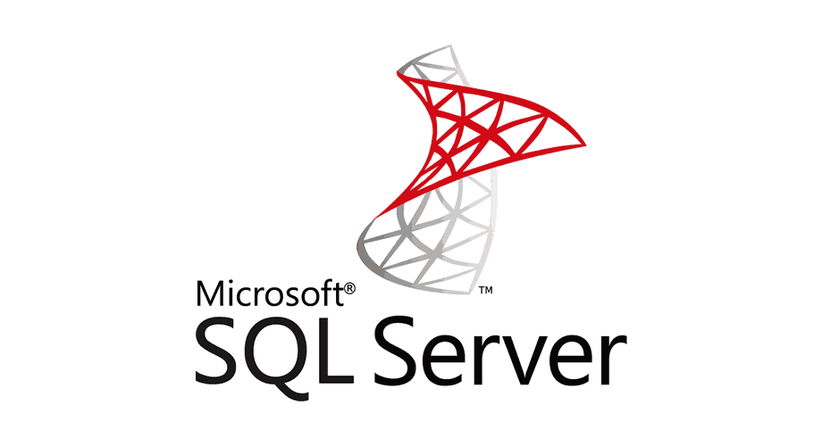

Slide 29
Microsoft SQL Server
SQL Server is RDBMS developed by Microsoft. SQL Server supports ANSI SQL, which is the standard SQL (Structured Query Language) language. However, SQL Server comes with its implementation of the SQL language, T-SQL (Transact-SQL).
Platform: MicroSoft Server, SQL server 2017 onwards it supports Docker Engine, Ubuntu, SUSE Linux Enterprise Server, and Red Hat Enterprise Linux.
Languages: C, C++, Java, and C#
Cloud Version: Yes
Features:
It provides integration of structured and unstructured data with the power of SQL Server and Spark.
The tool offers scalability, performance, and availability for mission-critical, intelligent applications, data warehouses, and data lakes.
It offers advanced security features to protect your data.
Access to rich, interactive Power BI reports, to make a faster and better decision.
SQL Server 2019 is the latest version.

Slide 30
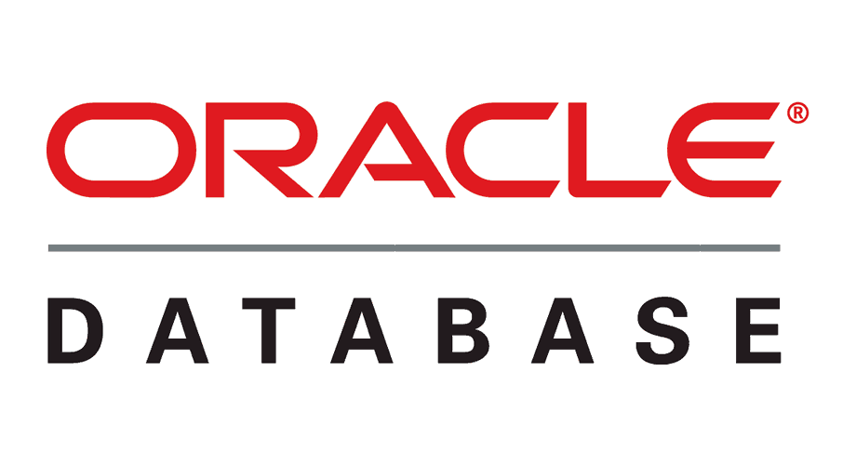

Slide 31
ORACLE Database
Oracle is self-repairing, self-securing, and self-driving designed to eliminate manual data management. It is an intelligent, secure, and highly available database in the cloud that helps you to grow your business.
Platform: Windows and Linux
Languages: C++, COBOL, C, Java, Visual Basic, and Pl/SQL.
Cloud Version: Yes
Features:
Oracle Cloud is optimized for high-performance database workloads, streaming workloads, and Hyperscale big data.
You can easily migrate to the Cloud.
It provides the services based on how you like to operate, in order to run Oracle cloud in your data center.
Latest version of Oracle is Oracle Database 19c (19.1.0 // 12.2.0.3)
Verdict: Oracle database stores and retrieve information. Database server solves the problem related to information management.

Slide 32


Slide 33
MariaDB
MariaDB is a fork of the MySQL database management system. It is created by its original developers. This DBMS tool provides data processing capabilities for both small and enterprise tasks.
Platform: Windows, Linux, and Mac.
Languages: C#, Java, C++, Python, etc.
Cloud Version: Yes
Features:
It operates under GPL, BSD or LGPL licenses.
It comes with many storage engines, including the high-performance ones that can be integrated with other relational database management systems.
It provides the Galera cluster technology.
MariaDB 10.5.5 is the latest stable version
MariaDB can run on different operating systems, and it supports numerous programming languages.

Slide 34
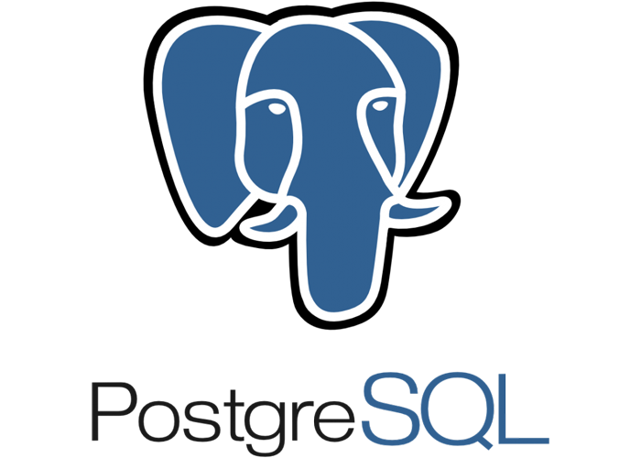

Slide 35
PostgreSQL
PostgreSQL is an enterprise-class open source database management system. It supports both SQL for relational and JSON for non-relational queries. It is backed by an experienced community of developers who have made a tremendous contribution to make it highly reliable Database management software.
Platform: Mac, Windows, and Linux.
Languages: PL/Tcl, PL/pgSQL, PL/Python, and PL/Perl.
Cloud Version: No.
Features:
Compatible with various platforms using all major languages and middleware
Standby server and high availability
The tool has mature server-side programming Functionality
Log-based and trigger-based replication SSL.
Notes:
PL – Procedure Language for PostgreSQL
Used to write function & trigger procedure.

Slide 36
PostgreSQL (cont…)
It offers a most sophisticated locking mechanism.
Support for multi-version concurrency control
It provides support for client-server network architecture
The tool is Object-oriented and ANSI-SQL2008 compatible
PostgreSQL allows linking with other data stores like NoSQL, which act as a federated hub for polyglot databases.
Verdict: PostgreSQL enables you to create custom data types and range of query methods. You can run a store procedure in different programming languages.

Slide 37


Slide 38
MongoDB
MongoDB is a document-oriented NoSQL database used for high volume data storage. It is a database which came into light around the mid-2000s. It falls under the category of a NoSQL database.
Platform: Cross-platform
Languages: C#, C, Java, C++, Perl, Scala, Ruby, etc.
Cloud Version: Yes
Features:
Fully Automated scale provision, and manage complex, highly available, multi-node clusters with easily with API calls.
This tool allows you to create globally distributed clusters.
Easy to restore data when needed.
It offers visualization, monitor, and alert on more than 80 metrics which track your cluster's health or integrate with third-party monitoring solutions.

Slide 39
MongoDB (Cont..)
The tool has a powerful query language
It uses rich JSON documents to store tables in a relational database.
It provides MongoDB Atlas, which is a global cloud database.
Verdict: MongoDB allows you to validate the document. It is not suitable for those applications having complex transactions.
db.inventory.insertMany( [
{ "item": "journal", "qty": 25, "size": { "h": 14, "w": 21, "uom": "cm" }, "status": "A" },
{ "item": "notebook", "qty": 50, "size": { "h": 8.5, "w": 11, "uom": "in" }, "status": "A" },
{ "item": "paper", "qty": 100, "size": { "h": 8.5, "w": 11, "uom": "in" }, "status": "D" },
]);

Slide 40


Slide 41
SQLite
SQLite is an open-source, embedded, relational database management system, designed circa 2000. It is a database, with zero configuration, no requirements of a server or installation. Despite its simplicity, it is laden with popular features of database management systems.
Platform: Blackberry, Symbian, Maemo, Android, MeeGo, WebOS, NetBSD, FreeBSD, illumos, Solaris 10, Windows, and Tizen.
Languages: C, C#, C++, Java, PHP, Python, Ruby, etc.
Cloud Version: Yes
Features:
SQLite is very lightweight compared to other database management systems like SQL Server, or Oracle.
It has an in-memory library that you can call and use directly without installation or configuration.
You do not require any dedicated server to store database. The database is stored in the hard disk of a computer.
Verdict: SQLite is a C programming language library which offers self-contained, reliable and full-featured SQL database engine.

Slide 42
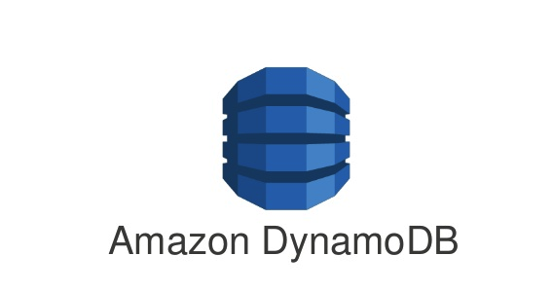

Slide 43
Amazon DyanmoDB
Amazon DynamoDB is a non-relational database. This database system provides consistent latency and offers built-in security and in-memory caching. DynamoDB is a serverless database which scales automatically and backs up your data for protection.
Platform: Cross-platform
Languages: Go, Node.js, Java, .NET, C#, Ruby, Python, PHP, and Perl.
Cloud Version: Yes
Features:
Key-value and document data model support.
DynamoDB offers secondary indexes which provide the flexibility to query on any attribute.
Amazon DynamoDB Accelerator delivers fast read performance for your DynamoDB.
DynamoDB integrates with AWS Lambda to provide triggers.
Verdict: DynamoDB is a document database and can be used for various purpose.
Notes:
NoSQL: Document Databases; Graph Databases; Key Value Databases, Horizontal Scability, Column Based.

Slide 44
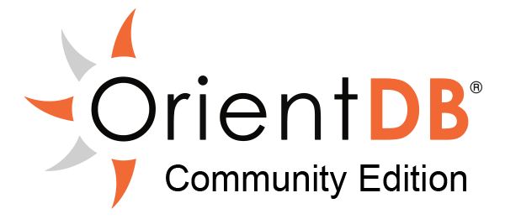

Slide 45
OrientDB
OrientDB is an open-source NoSQL multi-model database which helps organizations to unlock the power of graph databases without deploying multiple systems to handle other data types. This helps you to increase performance and security while supporting scalability.
Platform: Linux, Mac OS X, Windows, Solaris, and HP-UX
Languages: Java, PHP, Nodejs, .NET, Python, C, JavaScript, Ruby, Scala, Elixir, Android, Perl.
Cloud Version: Yes
Features:
Unified Multi-Model API – for quicker deployment
TinkerPop 3 for the state of fast and effective upgrades.
The tool focused on Scalability and performance.
Offers enhanced query planner.
Verdict: OrientDB has the ability to do multi-master replication, shared data using clusters, and automate distributed queries and transactions.

Slide 46


Slide 47
neo4j
Neo4j is an open-source NoSQL graph database, implemented in Java. It saves your data in graphs rather than in tables.
Platform: Cross-Platform
Languages: Java, Cypher Query Language, JavaScript, Java, etc.
Cloud Version: Yes
Features:
It supports graph analytics and transactional applications.
Continuous-time traversals for a relationship in the graph both in breadth and depth because of double linking on the storage level between node and relationship.
Relationship in Neo4j is fast and allows you to materialize and use new relationships later to "shortcut" and speed up the domain data when the new requirement arises
Memory caching for graphs that provide compact storage, resulting in efficient scale-up.
Verdict: Neo4j allows any organization to unlock its business value of connections, relationships in data, and influences through a new application.

Slide 48



Slide 49
CouchDB
CouchDB is open-source software that is based on the common standards to access your important data. It stores data on your server or with a leading service provider of your choice.
Platform: Cross-Platform
Languages: Java, Python, C++, Perl, C, JavaScript, PHP, etc..
Cloud Version: No
Features:
It enables you to run a logical database server on any virtual machines.
CouchDB tool works with external tools like load balancers, HTTP, and proxy servers.
The tool provides support of authentication and session.
CouchDB cluster enables you to save data redundantly.
Verdict: CouchDB offers a scalable solution. It also provides flexibility for storing data.

Slide 50
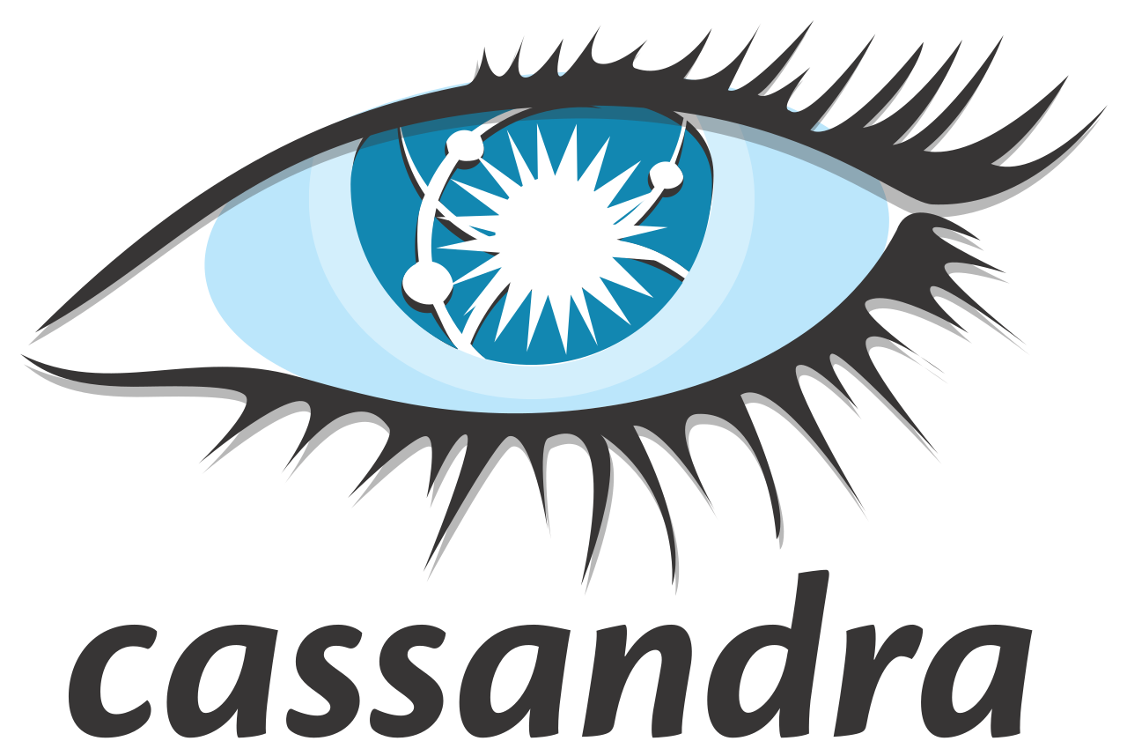

Slide 51
Cassandra
Cassandra is a free tool which is designed to manage a large amount of data across a wide range of servers. The tool offers support for replicating across multiple datacenters.
Platform: Cross-platform
Languages: SQL, Go, C++, Python, and Node JS
Cloud Version: Yes
Features:
Data is copied to numerous nodes to provide a fault-tolerance system.
There are no network bottlenecks as every node in the cluster is seperate.
The tool supports for contracts and services from third parties.
It allows you to choose between synchronous or asynchronous replication for the update.
Verdict: Cassandra is for those people who want scalability and high availability without decreasing performance.

Slide 52


Slide 53
Hadoop
Apache Hadoop is a collection of open-source software utilities that facilitate using a network of many computers to solve problems involving massive amounts of data and computation.
It provides a software framework for distributed storage and processing of big data using the MapReduce programming model.
Originally designed for computer clusters built from commodity hardware—still the common use—it has also found use on clusters of higher-end hardware. All the modules in Hadoop are designed with a fundamental assumption that hardware failures are common occurrences and should be automatically handled by the framework
Notes:
Developed by Appache Software foundation.

Slide 54
Hadoop (Cont..)
The core of Apache Hadoop consists of a storage part, known as Hadoop Distributed File System (HDFS), and a processing part which is a MapReduce programming model. Hadoop splits files into large blocks and distributes them across nodes in a cluster.
It then transfers packaged code into nodes to process the data in parallel.
Latest release 3.2.x , release on 22 September 2019

Slide 55
What is Data?
In Simple words, Data can be facts related to any object inconsideration.
For example your name, age, height, weight etc.
Data is a collection of a distinct small unit of information.
It can be used in a variety of forms like text, numbers, media, bytes, etc.
It can be stored in pieces of paper or electronic memory, etc.
Data are a set of values of qualitative or quantitative variables about one or more persons or objects, while a datum (singular of data) is a single value of a single variable.

Slide 56
What is Database?
A database is a collection of related data which represents some aspect of the real world.
A database system is designed to be built and populated with data for a certain task.
A database is an organized collection of data, so that it can be easily accessed and managed.
A database is an organized collection of structured information, or data, typically stored electronically in a computer system.
A database is usually controlled by a database management system (DBMS).
Together, the data and the DBMS, along with the applications that are associated with them, are referred to as a database system, often shortened to just database.

Slide 57
What is DBMS?
Database Management System (DBMS) is a software for storing and retrieving users' data while considering appropriate security measures. It consists of a group of programs which manipulate the database. The DBMS accepts the request for data from an application and instructs the operating system to provide the specific data. In large systems, a DBMS helps users and other third-party software to store and retrieve data.
DBMS allows users to create their own databases as per their requirement. The term “DBMS” includes the user of the database and other application programs. It provides an interface between the data and the software application.

Slide 58
Example of a DBMS
Let us see a simple example of a university database. This database is maintaining information concerning students, courses, and grades in a university environment. The database is organized as five files:
The STUDENT file stores data of each student
The COURSE file stores contain data on each course.
The SECTION stores the information about sections in a particular course.
The GRADE file stores the grades which students receive in the various sections
The TUTOR file contains information about each professor.

Slide 59

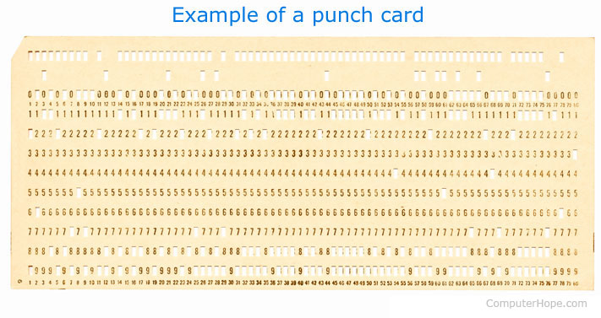
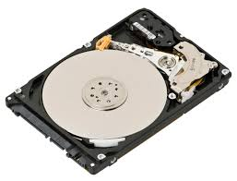
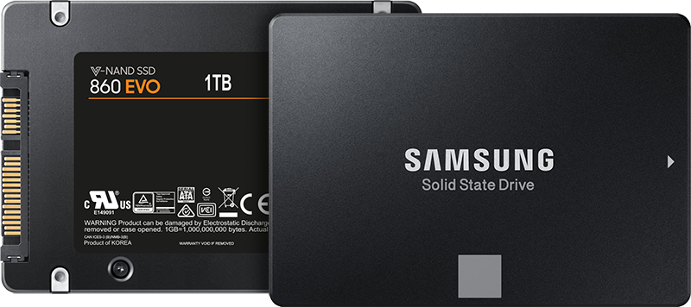
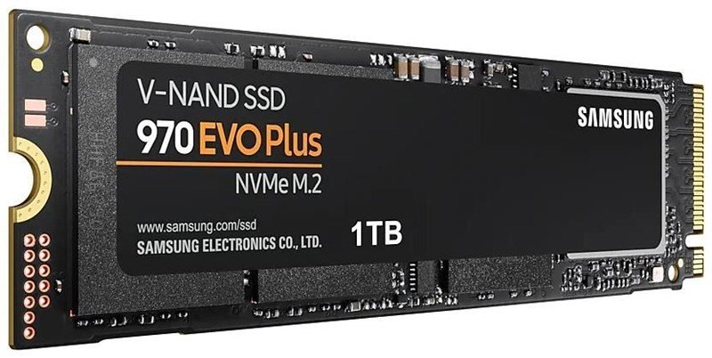
History of DBMS
1950s and early 1960s:
Data processing using magnetic tapes for storage
Tapes provided only sequential access
Punched cards for input
Late 1960s and 1970s:
Hard disks allowed direct access to data
Network and hierarchical data models in widespread use
Ted Codd defines the relational data model
Would win the ACM Turing Award for this work
IBM Research begins System R prototype
UC Berkeley (Michael Stonebraker) begins Ingres prototype
Oracle releases first commercial relational database
High-performance (for the era) transaction processing

Slide 60
History of DBMS (Cont..)
1980s:
Research relational prototypes evolve into commercial systems
SQL becomes industrial standard
Parallel and distributed database systems
Wisconsin, IBM, Teradata
Object-oriented database systems
1990s:
Large decision support and data-mining applications
Large multi-terabyte data warehouses
Emergence of Web commerce

Slide 61
History of DBMS (Cont..)
2000s
Big data storage systems
Google BigTable, Yahoo PNuts, Amazon,
“NoSQL” systems.
Big data analysis: beyond SQL
Map reduce and friends
2010s
SQL reloaded
SQL front end to Map Reduce systems
Massively parallel database systems
Multi-core main-memory databases

Slide 62
Characteristics of Database Management System
Provides security and removes redundancy
Self-describing nature of a database system
Insulation between programs and data abstraction
Support of multiple views of the data
Sharing of data and multiuser transaction processing
DBMS allows entities and relations among them to form tables.
It follows the ACID concept ( Atomicity, Consistency, Isolation, and Durability).
DBMS supports multi-user environment that allows users to access and manipulate data in parallel.

Slide 63
DBMS vs. Flat File
DBMS | Flat File Management System
Multi-user access | It does not support multi-user access
Design to fulfill the need for small and large businesses | It is only limited to smaller DBMS system.
Remove redundancy and Integrity | Redundancy and Integrity issues
Expensive. But in the long term Total Cost of Ownership is cheap | It's cheaper
Easy to implement complicated transactions | No support for complicated transactions

Slide 64
Users in a DBMS environment
Component Name | Task
Application Programmers | The Application programmers write programs in various programming languages to interact with databases.
Database Administrators | Database Admin is responsible for managing the entire DBMS system. He/She is called Database admin or DBA.
End-Users | The end users are the people who interact with the database management system. They conduct various operations on database like retrieving, updating, deleting, etc.

Slide 65
Popular DBMS Software
MySQL
Microsoft Access
Oracle
PostgreSQL
dBASE
FoxPro
SQLite
IBM DB2
LibreOffice Base
MariaDB
Microsoft SQL Server etc.

Slide 66
Application of DBMS
Sector | Use of DBMS
Banking | For customer information, account activities, payments, deposits, loans, etc.
Airlines | For reservations and schedule information.
Universities | For student information, course registrations, colleges and grades.
Telecommunication | It helps to keep call records, monthly bills, maintaining balances, etc.
Finance | For storing information about stock, sales, and purchases of financial instruments like stocks and bonds.
Sales | Use for storing customer, product & sales information.
Manufacturing | It is used for the management of supply chain and for tracking production of items. Inventories status in warehouses.
HR Management | For information about employees, salaries, payroll, deduction, generation of paychecks, etc.

Slide 67
Types of DBMS
Four Types of DBMS systems are:
Hierarchical database
Network database
Relational database
Object-Oriented database

Slide 68
Hierarchical DBMS
In a Hierarchical database, model data is organized in a tree-like structure. Data is Stored Hierarchically (top down or bottom up) format. Data is represented using a parent-child relationship. In Hierarchical DBMS parent may have many children, but children have only one parent.

Slide 69
Network Model
The network database model allows each child to have multiple parents. It helps you to address the need to model more complex relationships like as the orders/parts many-to-many relationship. In this model, entities are organized in a graph which can be accessed through several paths.

Slide 70
Relational model
Relational DBMS is the most widely used DBMS model because it is one of the easiest. This model is based on normalizing data in the rows and columns of the tables. Relational model stored in fixed structures and manipulated using SQL.

Slide 71
Object-Oriented Model
In Object-oriented Model data stored in the form of objects. The structure which is called classes that display data within it. It defines a database as a collection of objects which stores both data members values and operations.

Slide 72
Advantages of DBMS
DBMS offers a variety of techniques to store & retrieve data
DBMS serves as an efficient handler to balance the needs of multiple applications using the same data
Uniform administration procedures for data
Application programmers never exposed to details of data representation and storage.
A DBMS uses various powerful functions to store and retrieve data efficiently.
Offers Data Integrity and Security
The DBMS implies integrity constraints to get a high level of protection against prohibited access to data.
A DBMS schedules concurrent access to the data in such a manner that only one user can access the same data at a time
Reduced Application Development Time

Slide 73
Disadvantage of DBMS
Cost of Hardware and Software of a DBMS is quite high which increases the budget of your organization.
Most database management systems are often complex systems, so the training for users to use the DBMS is required.
In some organizations, all data is integrated into a single database which can be damaged because of electric failure or database is corrupted on the storage media
Use of the same program at a time by many users sometimes lead to the loss of some data.
DBMS can't perform sophisticated calculations

Slide 74
When not to use a DBMS system?
Although, DBMS system is useful. It is still not suited for specific task mentioned below:
Not recommended when you do not have the budget or the expertise to operate a DBMS. In such cases, Excel/CSV/Flat Files could do just fine.

Slide 75
Q&A

Slide 76
Thank You !!!

